Slide 1
Bankruptcy Prediction System
Group Members:-
Swaraj Deshmukh
Adwait Thangan
Deeksha Singhai
Abhishek dwivedi
Sandhra Sriraj

Slide 2






CONTENTS
What is Bankruptcy Prediction systems for?
Introduction
Conclusion
Importing Dataset & EDA
Visualisation
Model Building
Model Deployment
Streamlit

Slide 3
What is Bankruptcy Prediction systems for?

Slide 4

What is Bankruptcy Prediction systems for?
Bankruptcy prediction is the art of predicting bankruptcy and various measures of financial distress of public firms. It is a vast area of finance and accounting research. The importance of the area is due in part to the relevance for creditors and investors in evaluating the likelihood that a firm may go bankrupt.
The quantity of research is also a function of the availability of data: for public firms which went bankrupt or did not, numerous accounting ratios that might indicate danger can be calculated, and numerous other potential explanatory variables are also available. Consequently, the area is well-suited for testing of increasingly sophisticated, data-intensive forecasting approaches.

Slide 5
Importing Dataset & EDA

Slide 6

The data were collected from the Taiwan Economic Journal for the years 1999 to 2009. Company
bankruptcy was defined based on the business regulations of the Taiwan Stock Exchange.
All About the
Dataset
The dataset is structured data, contain 1 tareget column and 95 Variable columns

Slide 7
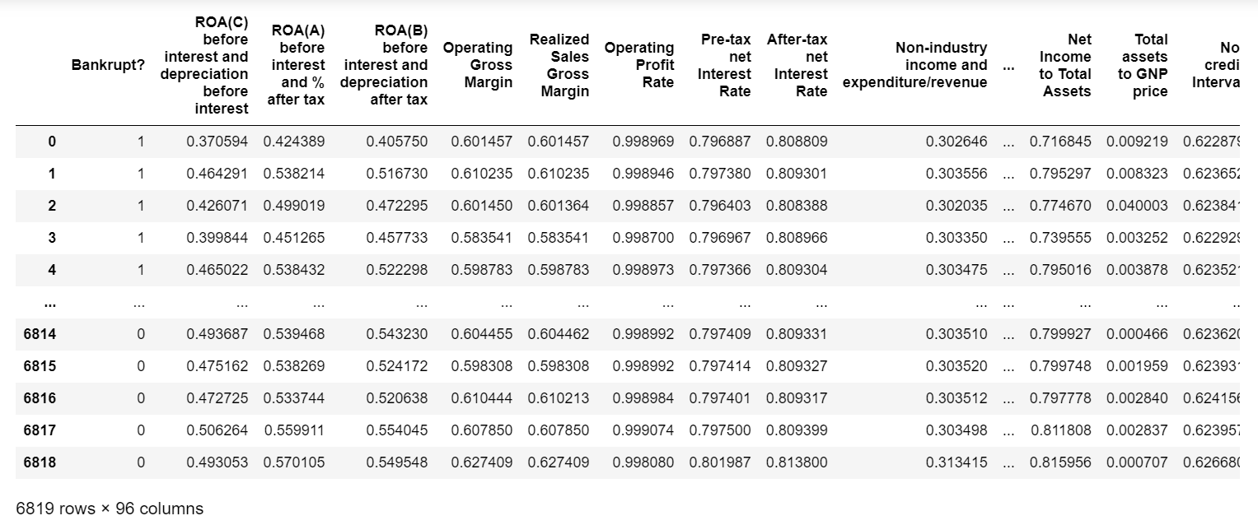
Dataset

Slide 8
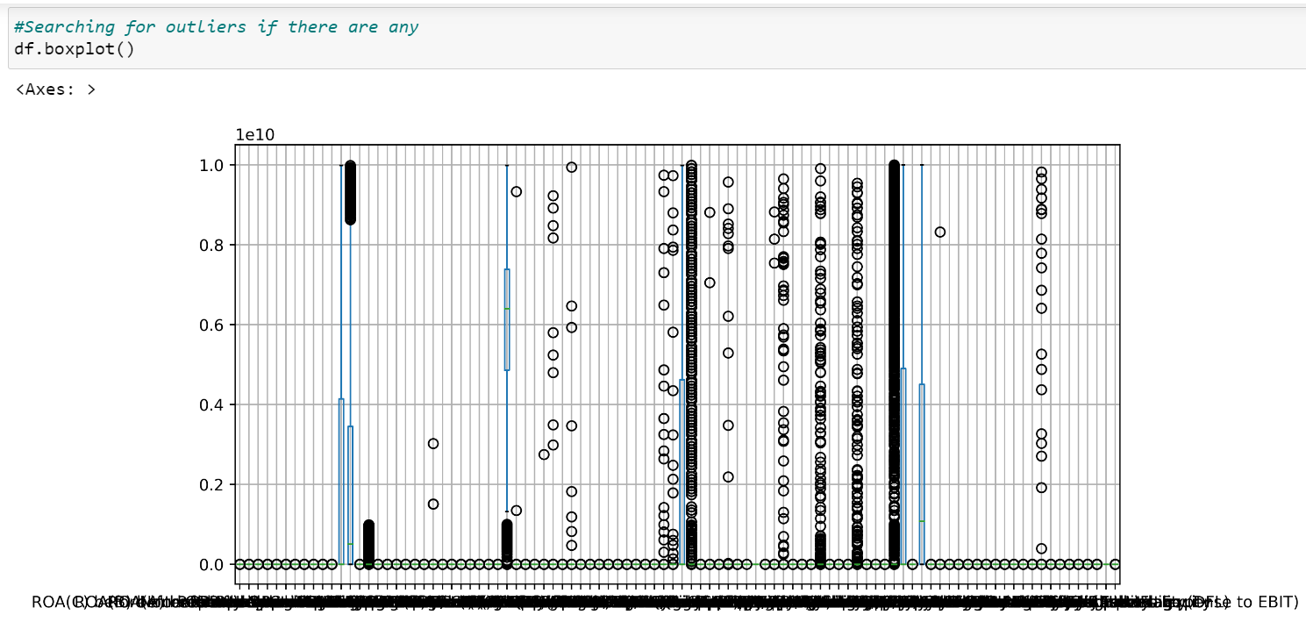
Preparing Data (Data Clean-up)
The Data dont have any missing values or null values
But the data have huge outlier in it

Slide 9
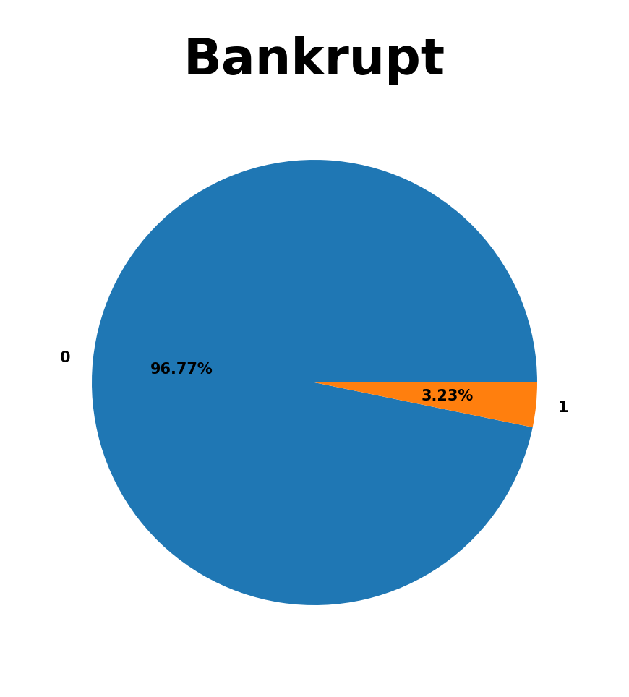
Also their is imbalance data in the target Column
Their are about 96.77% data is Non bankrupt and only 3.23% data is Bankrupt

Slide 10
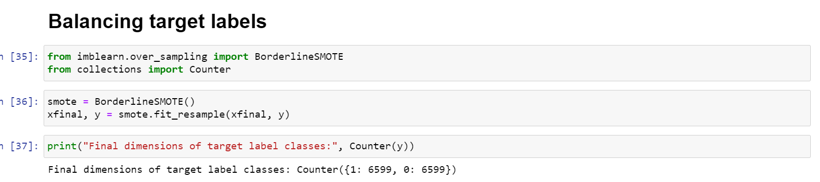
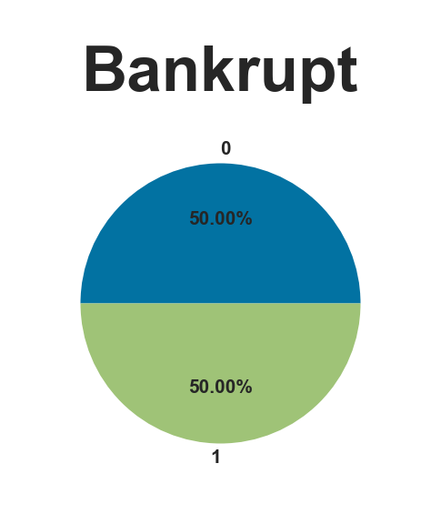

Slide 11
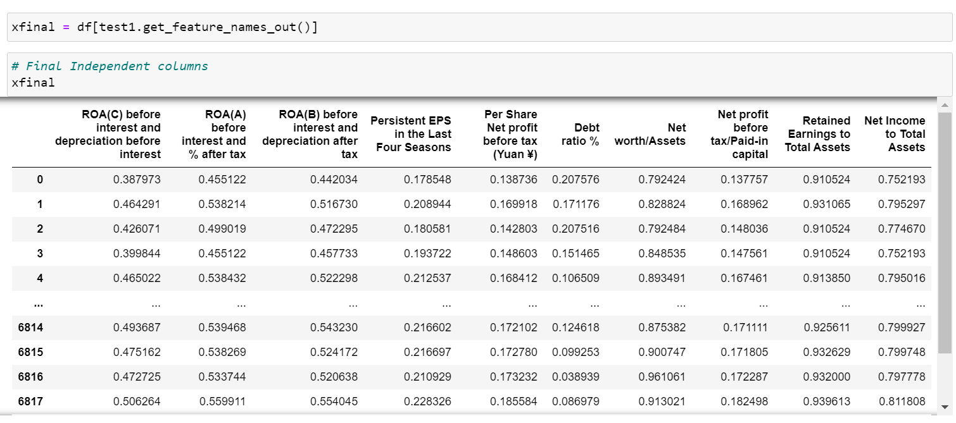
Features Selection
There are about 95 independant variables in the data set.
So we use feature engineering for selecting top 10 feature

Slide 12
Model Building

Slide 13
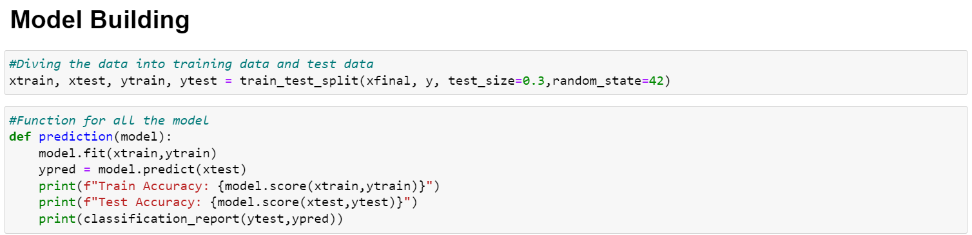
Model Building
For the different models we creat a function for it

Slide 14
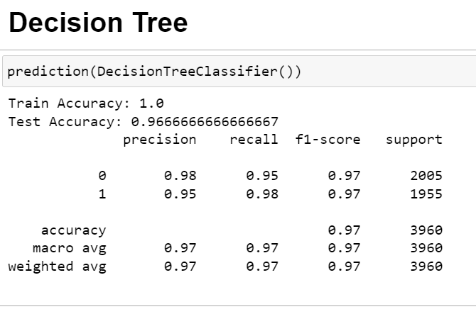
Decision Tree

Slide 15
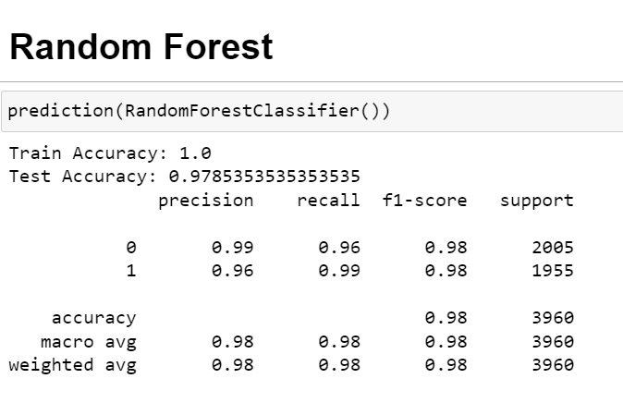
Random Forest

Slide 16
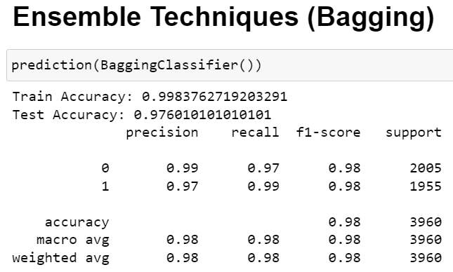
Ensemble Techniques Bagging

Slide 17
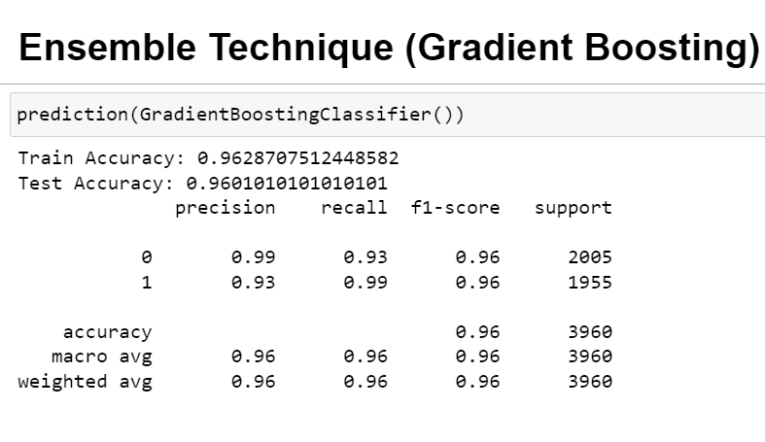
Gradent Boostin

Slide 18
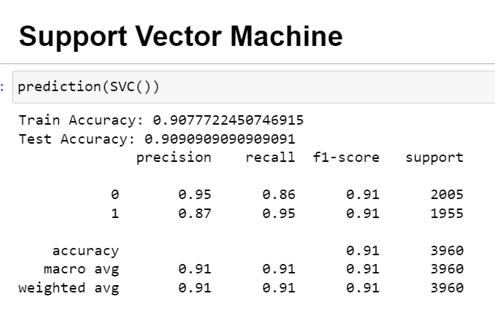
Support Vector Machine

Slide 19
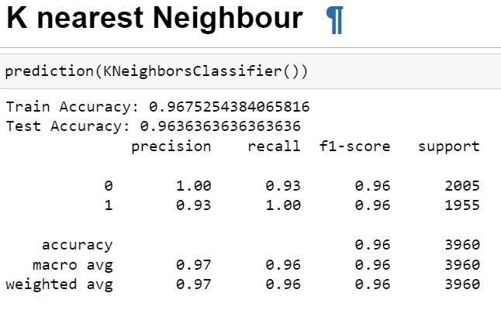
KNN

Slide 20
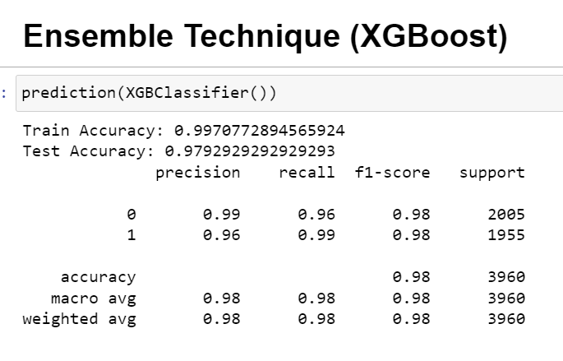
XGradent Boosting

Slide 21
Model Evaluation & Testing

Slide 22
XGradent Boosting
The XGBoosting show highest Accuracy so we select it foe model deployment

Slide 23
Model Deployment

Slide 24


Application Used For Deployment
Spyder:Spyder is a free and open-source scientific environment for Python, combining advanced analysis, debugging, editing, and profiling with data exploration.
Streamlit: It is an open-source Python library that makes it easy to create and share custom web apps for machine learning and data science. By using Streamlit you can quickly build and deploy powerful data applications.

Slide 25
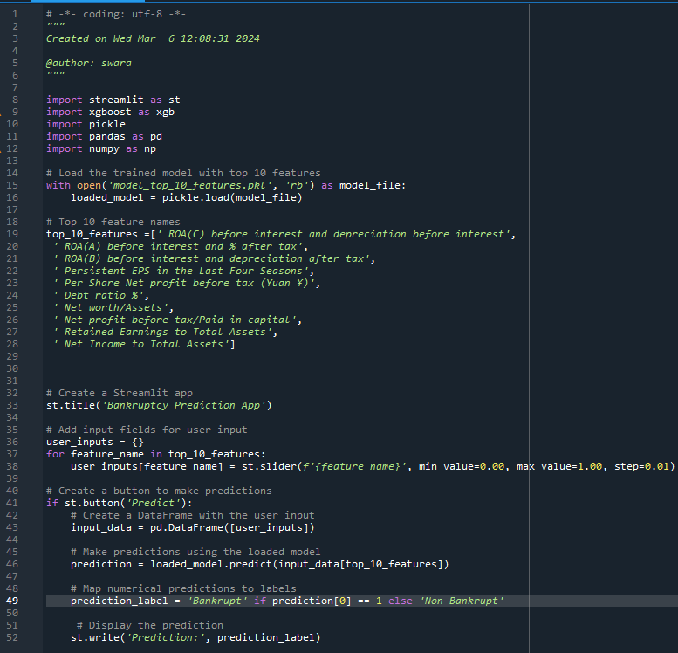
Spyder Code

Slide 26
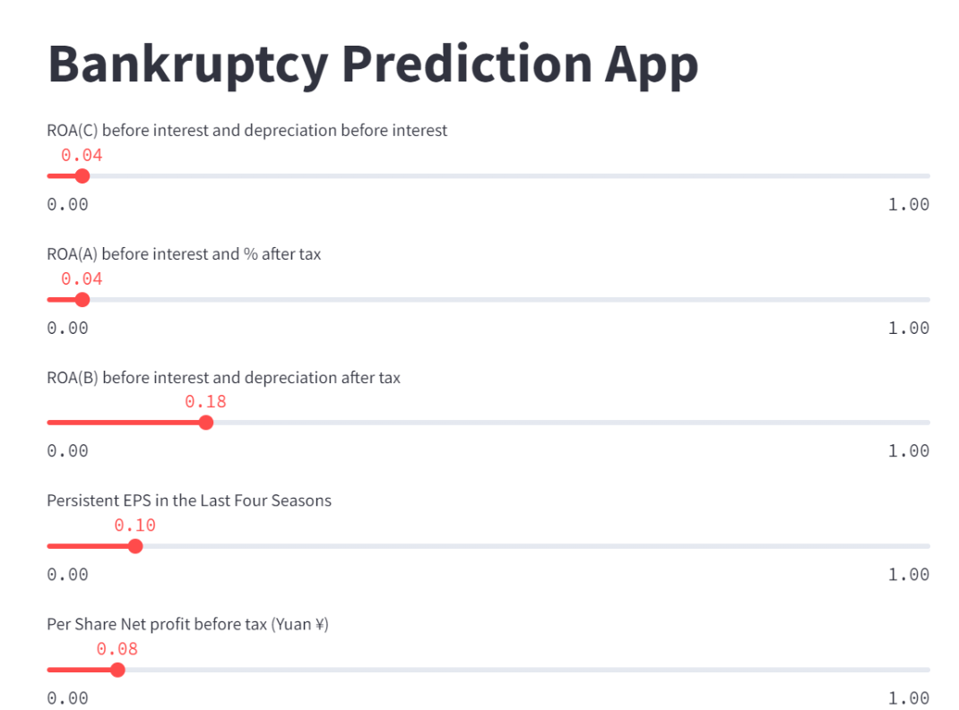
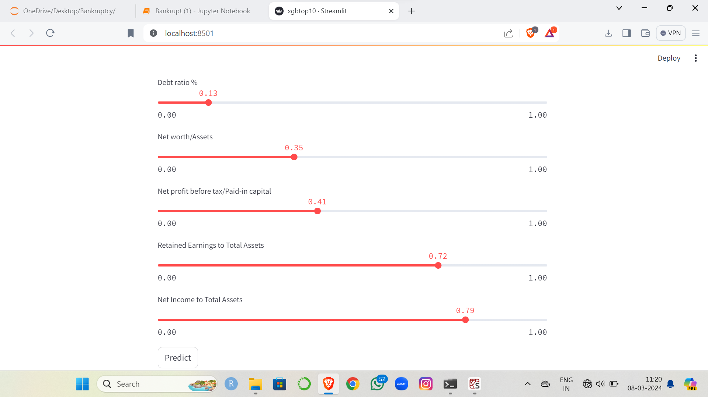
Streamlit WebPortal

Slide 27


